Slide 1

Functions: Building Blocks of Python
Functions are fundamental to Python programming. They are reusable blocks of code that perform specific tasks. Using functions makes your code more organized, efficient, and easier to maintain.
Functions allow you to break down complex problems into smaller, manageable components. This modular approach makes your code more readable and understandable. Functions can also be reused in different parts of your program or even in other programs.
def greet(name):
"""Greets a person by name."""
print(f"Hello, {name}!")
greet("Alice")
greet("Bob")

Slide 2
What are Functions?
Reusable Code Blocks
Modular Organization
Functions are like mini-programs that perform specific tasks within your larger program. They encapsulate a calculation or a set of instructions. Once you define a function, you can call it multiple times, avoiding code repetition.
Functions help break down complex programs into smaller, well-defined units. This modular approach makes your code easier to read, understand, and maintain. It's easier to find and modify code when it's organized into functions.
def greet(name):
"""This function greets the user."""
print(f"Hello, {name}!")
greet("Alice") # Output: Hello, Alice!
greet("Bob") # Output: Hello, Bob!
def calculate_area(length, width):
"""Calculates the area of a rectangle."""
area = length * width
return area
rectangle_area = calculate_area(5, 10)
print(f"Area: {rectangle_area}") # Output: Area: 50

Slide 3


Why Use Functions?
Code Organization
Reusability
Functions break down complex programs into smaller, more manageable pieces. This helps to organize code logically and improves readability, making it easier to understand and maintain.
Functions can be reused multiple times within a program or even across different projects. This saves time and reduces redundancy by eliminating the need to write the same code repeatedly.
def greet(name):
print("Hello,", name + "!")
greet("Alice")
greet("Bob")
def calculate_area(length, width):
area = length * width
return area
rectangle_area = calculate_area(5, 3)
print("Rectangle Area:", rectangle_area)
square_area = calculate_area(4, 4)
print("Square Area:", square_area)

Slide 4
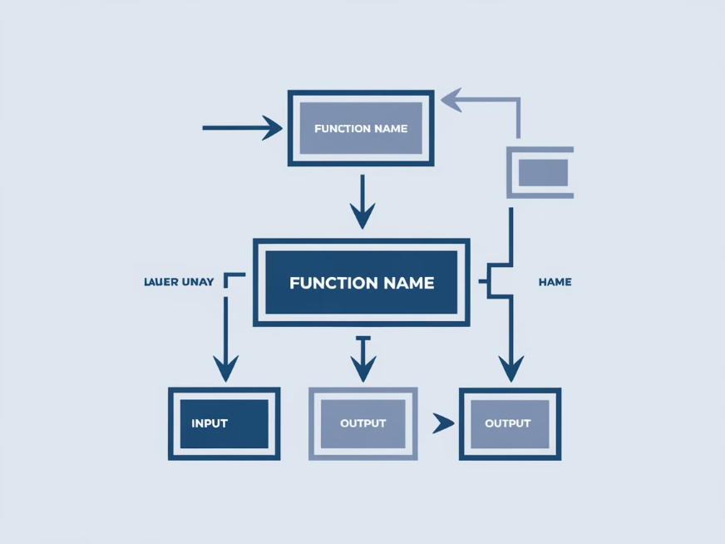
Anatomy of a Function
Functions are defined using the 'def' keyword, followed by the function name, parentheses, and a colon. The code block within the function is indented. This indented code block contains the instructions for the function to execute. When a function is called, its instructions are executed, and any results are returned to the caller.
Functions make code more modular and reusable. They improve code organization and readability. Functions break down complex tasks into smaller, manageable units. Functions can be called multiple times from different parts of the program, eliminating the need for repeated code.
Here is an example of a simple function that adds two numbers together:
def add_numbers(a, b):
"""Adds two numbers together.
Args:
a: The first number.
b: The second number.
Returns:
The sum of a and b.
"""
return a + b
# Call the function
result = add_numbers(3, 5)
# Print the result
print(result)

Slide 5
Built-In Functions
Python comes with a set of built-in functions that are ready to use. These functions perform common tasks, making your coding easier and faster. They save you from writing the same code repeatedly.
Built-in functions cover a wide range of operations, including data manipulation, calculations, string handling, input/output, and more. They are essential tools for any Python developer, helping you write efficient and effective code.

Slide 6
Commonly Used Built-In Functions
1
1. Input()
2
2. Print()
The `input()` function lets you get user input in your Python programs.
The `print()` function displays output on the screen. You can print messages, values, or results from your code.
Example:
Example:
name = input("What is your name? ") print("Hello,", name)
age = 25 print("Your age is:", age)
3
3. Len()
4
4. Type()
The `len()` function tells you how long a sequence (like a string, list, or tuple) is.
The `type()` function tells you what kind of data a variable holds.
Example:
Example:
number = 10 data_type = type(number) print("The data type of the variable is:", data_type)
message = "Hello World" length = len(message) print("The length of the message is:", length)

Slide 7



Defining Your Own Functions
Functions are reusable blocks of code that make your programs more organized, efficient, and easier to maintain. They break down complex tasks into smaller, manageable units, improving code modularity and readability. Using functions eliminates redundant code by promoting code reuse.
Define the function
Use the 'def' keyword, followed by the function name and parentheses. This defines the function and gives it a name.
1
def greet(): pass
Write the function body
The indented code inside the function is known as the function body. It contains the instructions that the function will execute when called.
2
def greet(): print("Hello!")
Call the function
To execute the function, use its name followed by parentheses. This triggers the function's execution, running the code within its body.
3
def greet(): print("Hello!") greet()
For example, you could create a function named 'greet' that prints a greeting message. You can then call this function whenever you need to display the greeting.

Slide 8
Enhancing Function Flexibility
Functions are incredibly versatile tools that add flexibility to our code. They allow us to pass in data, known as arguments, when calling the function. These arguments are then used within the function's logic, making it dynamic and adaptable to different situations.
Consider a function called `greet_user` that takes a `name` as an argument. When called, it prints a personalized greeting based on the provided name.
def greet_user(name):
print(f"Hello, {name}! Welcome.")
greet_user("Alice") # Output: Hello, Alice! Welcome.
greet_user("Bob") # Output: Hello, Bob! Welcome.
Another example is the `calculate_area` function which takes two arguments: `length` and `width`. This function calculates and returns the area of a rectangle.
def calculate_area(length, width):
area = length * width
return area
result = calculate_area(5, 10) # Calculate area of a rectangle with length 5 and width 10
print(result) # Output: 50
Finally, we can create a function called `sum_numbers` that takes two numbers as arguments and returns their sum.
def sum_numbers(num1, num2):
sum = num1 + num2
return sum
result = sum_numbers(15, 25) # Calculate the sum of 15 and 25
print(result) # Output: 40

Slide 9

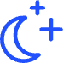
Default Parameter Values
Flexibility
Code Clarity
Default values make functions more flexible. You can call a function with or without providing specific values for certain arguments, allowing for different use cases.
Default values improve code readability. They make it clear what values are expected if no arguments are explicitly provided, leading to more maintainable code.
def greet(name="World"):
print(f"Hello, {name}!")
greet() # Output: Hello, World!
greet("Alice") # Output: Hello, Alice!
def calculate_discount(price, discount_rate=0.1):
discount = price * discount_rate
return price - discount
price = 100
print(calculate_discount(price)) # Output: 90.0
print(calculate_discount(price, discount_rate=0.2)) # Output: 80.0

Slide 10
Keyword Arguments
1
Flexibility in Function Calls
2
Enhanced Readability
3
Optional Arguments
Keyword arguments give you more flexibility when using functions. You can specify values by name, regardless of their order in the function's definition, making it easier to call functions with different combinations of arguments.
Keyword arguments make your code easier to read. They clearly show what each argument does, making it easier to understand the purpose of the code and reducing the chance of errors.
Keyword arguments allow you to create optional parameters in your functions. If a keyword argument is not provided when calling a function, it will use a default value you've set.
def calculate_area(length, width): return length * width area = calculate_area(width=5, length=10) # More readable than calculate_area(10, 5)
def greet(name, message="Hello"): print(message + ", " + name + "!") greet("Charlie") # Hello, Charlie! (message defaults to "Hello") greet("David", message="Good morning") # Good morning, David!
def greet(name, message="Hello"): print(message + ", " + name + "!") greet(name="Alice", message="Hi") # Hi, Alice! greet(message="Greetings", name="Bob") # Greetings, Bob!

Slide 11

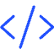


The return Statement
Sending Values Back
Example
Function's Output
The return statement enables functions to send back a value to the code that called them. This allows the returned value to be used for further calculations, printing, or any other purpose.
Consider a function designed to calculate the sum of two numbers. The return statement would send this computed sum back to the calling code.
The return statement acts as a way for functions to communicate their result back to the main program. This principle promotes code modularity and reusability.
def calculate_area(length, width): return length * width area = calculate_area(10, 5) print(area) # Output: 50
def get_greeting(name): return "Hello, " + name + "!" greeting = get_greeting("Alice") print(greeting) # Output: Hello, Alice!
def add_numbers(a, b): return a + b result = add_numbers(5, 3) print(result) # Output: 8

Slide 12



Void Functions
No Return Value
One-Way Operation
Example
Void functions are designed to perform specific actions without returning any value to the calling code. They are commonly used for tasks like displaying output, modifying data directly, or interacting with external systems. Example:
Think of a void function as a one-way street. They take data as input, execute their operations, and then conclude without sending anything back. Since the caller doesn't expect a value in return, the "return" keyword is omitted. Example:
Consider a function that prints a welcome message. It doesn't return any value; it simply performs the task of printing the message. This is a classic example of a void function. Example:
def print_message(): print("This is a message from a void function.")
def greet(name): print("Hello,", name)
def square(number): number = number * number

Slide 13




Scope of Variables
Local Scope
Global Scope
Modifying Global Variables
Variables declared within a function have local scope, meaning they are only accessible within that function. For example:
Variables declared outside of any function have global scope, making them accessible from anywhere in the program. For instance:
To modify a global variable inside a function, you need to use the `global` keyword. This signals to Python that you want to work with the global version of the variable, not a local copy. For example:
def my_function(): x = 10 print(x) my_function() # Output: 10 print(x) # Error: NameError: name 'x' is not defined
y = 20 def another_function(): print(y) another_function() # Output: 20 print(y) # Output: 20
z = 5 def change_global(): global z z = 15 change_global() print(z) # Output: 15

Slide 14
Nested Functions
Functions can be defined inside other functions, creating a hierarchical structure that promotes modular and organized code. Nested functions have access to variables defined in the outer function's scope, but not vice versa.
Outer Function
This defines the overall scope. For example:
def outer_function(x): def inner_function(y): return x + y return inner_function(5) result = outer_function(3) print(result) # Output: 8
1
Variables
Nested functions can access variables declared within the outer function. However, variables defined within the nested function are not visible to the outer function.
def outer_function(x): y = 5 def inner_function(z): return x + y + z return inner_function(2) result = outer_function(3) print(result) # Output: 10
2
Nested functions are particularly useful for complex tasks that can be broken down into smaller, more manageable units. They also enhance code reusability, allowing you to apply specific functionalities within different contexts.

Slide 15
Lambda Functions
Definition
Lambda functions in Python are like mini, nameless functions. They are short and sweet, perfect for quick tasks without needing a full-blown function. Imagine them as one-line shortcuts for simple operations.
# Example: Squaring a number using a lambda function square = lambda x: x * x print(square(5)) # Output: 25
Syntax
The basic syntax of a lambda function is as follows:
lambda arguments: expression

Slide 16
Function Overloading
Concept
Workaround
Example
Python doesn't directly support function overloading, which involves having multiple functions with the same name but different parameters. This is because Python uses dynamic typing, determining the function to call based on the arguments passed at runtime.
To achieve similar functionality, you can utilize default parameter values within functions. This allows a single function to handle different parameter combinations. Alternatively, you can employ *args and **kwargs for flexible function arguments.
For instance, you can define a function with optional parameters, enabling different calls based on the provided arguments. Python's flexibility and dynamic nature make it adaptable to various programming scenarios. Here's an example using default parameters:
def greet(name, greeting="Hello"):
print(f"{greeting}, {name}!")
greet("Alice") # Output: Hello, Alice!
greet("Bob", "Hi") # Output: Hi, Bob!

Slide 17


Function Documentation
Docstrings
Code Readability
Docstrings are multiline strings used within triple quotes to document functions. They clearly explain the function's purpose, parameters, return values, and any side effects.
Well-documented code is easier to understand and maintain. Docstrings significantly enhance code readability, helping other developers understand how a function works and how to use it correctly. This is especially important for larger projects or collaborative development environments.
def greet(name):
"""
Greets a user by name.
Args:
name: The name of the user.
Returns:
A string greeting the user.
"""
return f"Hello, {name}!"

Slide 18



Interactive Q&A
Ask Away
We're Here to Help
Got questions about Python functions? This is your chance to ask! We've covered a lot of ground, from the basics to advanced concepts. Don't hesitate to ask about anything unclear or if you want to explore specific use cases.
We're here to help you understand the power and flexibility of functions in Python. Let's clear up any confusion and explore some exciting use cases together!
Example: Defining a simple function

